Slide 1
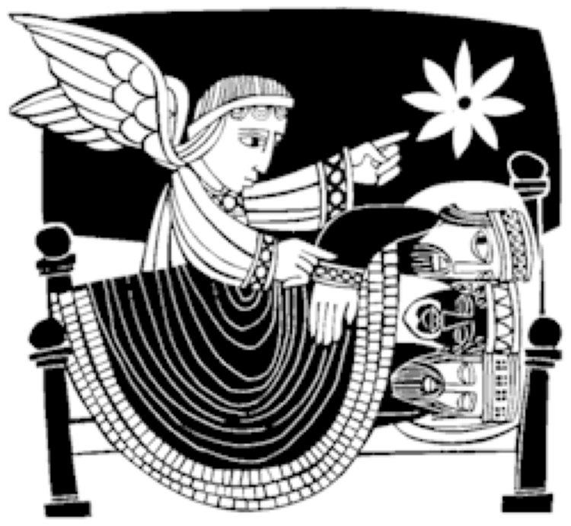
Reflection for Epiphany
The pilgrimage
of faith

Slide 2
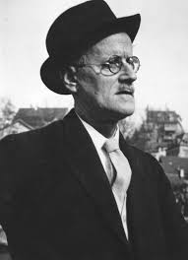
James Joyce
Borrowed the religious term ‘Epiphany’
A Portrait of the Artist as a Young Man.
"a sudden spiritual manifestation, whether in the vulgarity of speech or of gesture or in a memorable phase of the mind itself…”
moments of heightened poetic perception.
Joyce's term was then used to describe a common feature of the modernist novel, with authors as varied as Virginia Woolf, Marcel Proust, Ezra Pound, and Katherine Mansfield all featuring these sudden moments of vision as an aspect of the contemporary mind.

Slide 3
But…a challenge to this abstract interiority…
In a Sunday newspaper in early January 2017, Ruth Whippman challenged the popularity of what has come to be known as ‘mindfulness’ and its promise of inner happiness. She argued that the idea that ‘happiness comes from within’ has taken a deep hold in our collective consciousness in recent times. We have learned to see well-being as an inner journey, as a personal quest, rather than as something to do with community or with others. We have focused on private and emotional experience as the root of happiness, and pursued the exploration of our inner lives at the expense of engaging with the outside world. She writes,
‘Our narrative of well-being has become divorced from community, social justice or wider political responsibility.’
Ruth Whippman (2017) The Observer, p.52

Slide 4
What we need now, she argues, is not inner exploration, but outward engagement. Now is not the time to journey ‘withinwards’, but to look outside ourselves. It is in looking outside ourselves that we will truly find happiness. Or, you might say, echoing Jesus himself, that it is only when we lose our selves that we will find them.
***
So in this time, I want to explore what it would mean for us to think of Epiphany not so much as an inner moment of seeing light, but as something that calls us out of ourselves to a journey towards the light of Christ… and towards engagement with the world. Christianity is not an abstract faith, but an embodied practice amidst the dust of life.

Slide 5
Scripture: Matthew 2: 1-2, 8a, 9-11
Jesus was born at Bethlehem in Judaea during the reign of Herod. After his birth astrologers from the east arrived in Jerusalem, asking ’Where is the new born king of the Jews? We observed the rising of his star and we have come to pay him homage….
He sent them to Bethlehem… after hearing what the king had to say they set out; there before them was the star they had seen rising, and it went ahead of them until it stopped above the place where the child lay. They were overwhelmed at the sight of it and entering the house they saw the child with Mary his mother and bowed low in homage to him; they opened their treasure chests and presented gifts to him: gold, frankincense and myrrh. Then they returned to their own country by another route…’

Slide 6
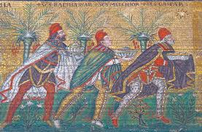
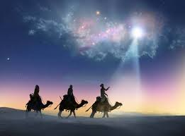
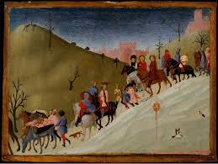
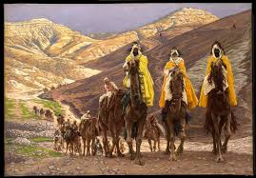
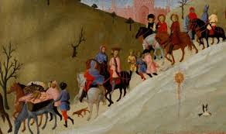
The magi…
They brought gifts
They were Gentiles
They were star gazers
They were wise
They went on a journey...

Slide 7
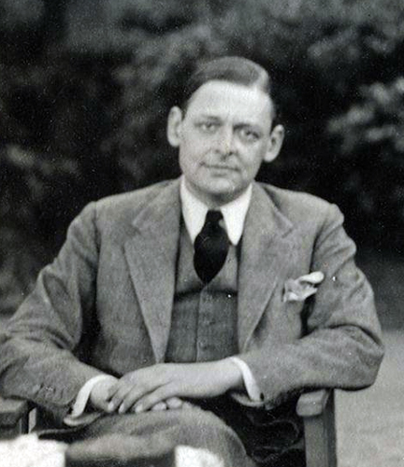
The journey of the Magi T.S.Eliot
‘A cold coming we had of it,
Just the worst time of the year
For a journey, and such a long journey:
The ways deep and the weather sharp,
The very dead of winter.’
And the camels galled, sore-footed, refractory,
Lying down in the melting snow.
There were times we regretted
The summer palaces on slopes, the terraces,
And the silken girls bringing sherbet.

Slide 8
Then the camel men cursing and grumbling
And running away, and wanting their liquor and women,
And the night-fires going out, and the lack of shelters,
And the cities hostile and the towns unfriendly
And the villages dirty and charging high prices:
A hard time we had of it.
At the end we preferred to travel all night,
Sleeping in snatches,
With the voices singing in our ears, saying
That this was all folly.

Slide 9
Then at dawn we came down to a temperate valley,
Wet, below the snow line, smelling of vegetation;
With a running stream and a water-mill beating the darkness,
And three trees on the low sky,
And an old white horse galloped away in the meadow.
Then we came to a tavern with vine-leaves over the lintel,
Six hands at an open door dicing for pieces of silver,
And feet kicking the empty wine-skins,
But there was no information, and so we continued
And arrived at evening, not a moment too soon
Finding the place; it was (you may say) satisfactory.

Slide 10
All this was a long time ago, I remember,
And I would do it again, but set down
This set down
This: were we led all that way for
Birth or Death? There was a Birth, certainly,
We had evidence and no doubt. I had seen birth and death,
But had thought they were different; this Birth was
Hard and bitter agony for us, like Death, our death.
We returned to our places, these Kingdoms,
But no longer at ease here, in the old dispensation,
With an alien people clutching their gods.
I should be glad of another death.
This poem is in the public domain. Published in Poem-a-Day on December 24, 2023, by the Academy of American Poets.

Slide 11
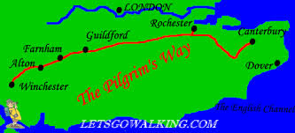
Pilgrimage
Growing up in the part of England I did meant I went for countless walks along paths that were called the ‘Pilgrims Way’.

Slide 12
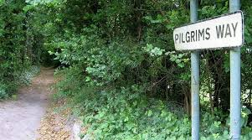
Sometimes I would find and explore the ruins of a long-closed abbey, playing amongst the ruined arches and grassed aisles. The road where I lived, where I learned to ride a bicycle and where I met friends, was called Friars Gate, and the local beer came from a brewery called The Friary. But there were no pilgrims or friars walking the way anymore and these names were no more than echoes of a lost world.

Slide 13
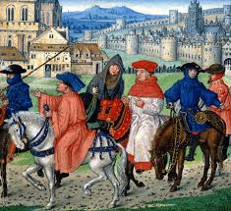
At school I read and enjoyed the first major literary work in anything like contemporary English - Chaucer’s famous Canterbury Tales with his stories of those who were travelling on pilgrimage for all sorts of holy and unholy reasons.

Slide 14
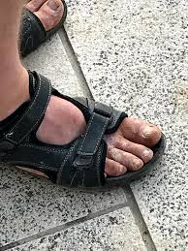
The landscape in which I grew up was full of these faint echoes of a world that had been lost in England, a world in which pilgrimage was once the only way that most people could or did travel, and a way of believing and belonging to the church.
This was a world infused with sacredness
and mystery, where relics were treasured
and journeys were undertaken in the hope
of finding God or healing. It was a world
outlined by worn paths and ancient routes, marked out by guest houses and hospitality, a world that called on people of all classes and types to walk together, a world that combined prayer, movement and the seeking of a better life and world in one.

Slide 15
Pilgrimages were (I was taught), at their best, little more than holidays and often an excuse to set aside the moral codes of home. At their worst there were those who exploited the faithful, taking their money in exchange for the touch of a relic or to have prayers said or indulgences granted. I learned, in my childhood and teenage years, that pilgrimages did not inspire or encourage holy behavior or true piety, and that they were often ruthlessly exploitative.They were outward practices emptied of real meaning and integrity, little more than a way to create income for religious communities, of sustaining a whole travel industry and of persuading those desperate for healing to part with their money.

Slide 16
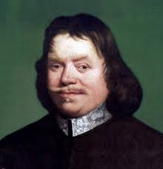
Faith (and thus pilgrimage) as an ’inner’ experience…
Faith became more about an inner journey for my soul, the ‘withinness’ of it most important. A Quiet Time, to journal about my faith and to believe that if I were any sort of pilgrim it was a metaphorical one. - - personal and inner progress in the spiritual life
One book which, along with the Bible, dominated Protestant piety in England for centuries. John Bunyan’s Pilgrims Progress
Pilgrimage becomes a metaphor for
an inner journey of faith
rather than an outer journey
to a real physical place or holy site.

Slide 17
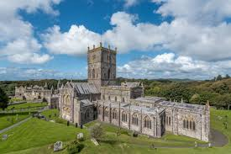
But now a shift and a revisiting that the magi might have understood…
From the website of St David’s Cathedral:
Pilgrimage today
’Today there is a rising interest in the idea of journeying and pilgrimage for many different reasons. Not only will people venture on a pilgrimage as a response to faith but also to enable them to gain perspective on some issue or stage in their lives, for the benefits of health and wellbeing or to find a greater connection with creation.’

Slide 18
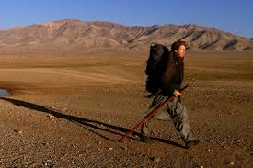
“I found incredible kindness, dignity and hospitality in both Iraq and Afghanistan - am only alive because of it - the most worthwhile lesson of a twenty month walk to these countries was a deepening appreciation of the kindness of strangers.” Rory Stewart

Slide 19
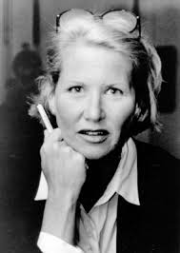
Annie Dillard Pilgrim at Tinker Creek
The Blue Ridge Mountains of Virginia…
a life of attention
and immersion in a place..
unsentimental and deeply revealing…
…’the wonder is that all the forms are not monsters, that there is beauty at all… Beauty itself is the fruit of the creator’s exuberance that grew such a tangle, and the grotesques and the horrors bloom from that same free growth, that intricate scramble and twine up and down the conditions of time.
This, then, is the extravagant landscape of the world, given, given with pizzazz, given in good measure, pressed down, shaken together, and running over.’ (p.148)

Slide 20
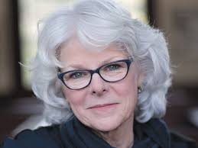
Barbara Brown Taylor
‘Sometimes we do not know what we know until it comes to us through the soles of our feet, the embrace of a tender lover, or the kindness of a stranger. Touching the truth with our minds alone is not enough. We are made to touch it with our bodies.’
Barbara Brown Taylor. (2009) An Altar in the World. Finding the Sacred Beneath our Feet. Canterbury Press, Norwich, p. 62

Slide 21

Phoebe

Slide 22
Pilgrimage with Phoebe
‘… I continue to feel a sense of being trapped. It’s horrible that I can’t even play with her for fear that she will bite. There was one point when she really got hold of my whole lower arm. Everyone says it is normal and will pass. But that doesn’t really help me feel any better right now. Again I am thinking about all the different possible escape routes, all of them. I feel wretched about the situation and about my reaction to it. How weak I am and how stupid to have got myself here. How many times have I told myself not to commit to things without really thinking it through? How many times have I thought I was being brave and adventurous and then regretted it? Why can’t I learn to know myself better and be honest and about my limits? ‘

Slide 23
Pilgrimage with Phoebe
‘…There was an interesting article in the Observer about how hedonism is not what we want; a meaningful life is the thing that makes it worthwhile, and what makes a life meaningful often involves suffering. I think I do understand this. I have introduced into my life now something that makes it more meaningful and purposeful, but it’s not hedonistic pleasure – it’s hard work that promises lots of rewards, but demands something and teaches a great deal in the process. I have moments of sensing freedoms curtailed (looking ahead it’s hard to know how some things will be possible or whether they will have to be foregone), but I do recognise that freedom in its truest form is not just doing what you want in a hedonistic sense.‘

Slide 24
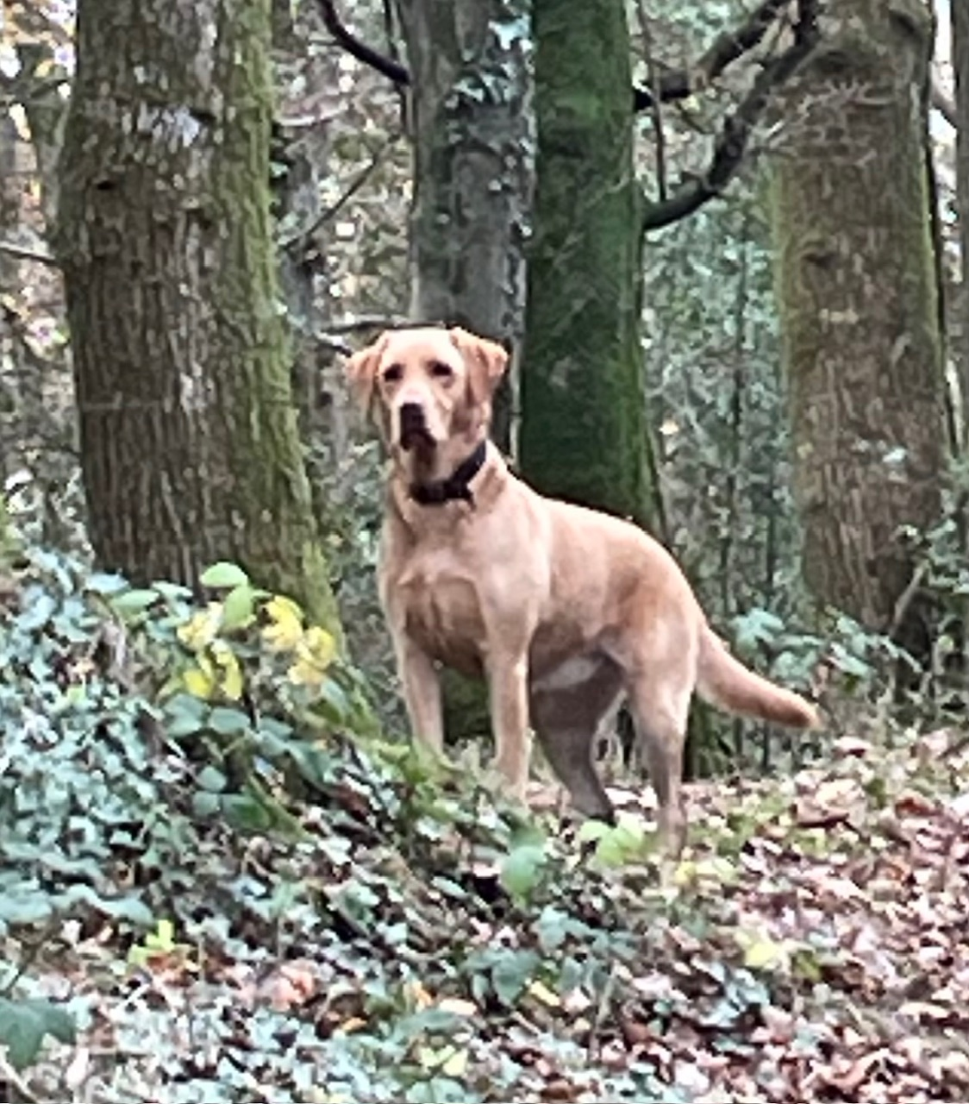
Pilgrimage with Phoebe
‘The final reflection for the Week of Prayer for Christian Unity – the eighth day – brought me some hope. The magi needed to go by another road. They went another way and God called them to change direction. There was danger, but God provided another way. A fresh start is always possible. Phoebe is very good
at fresh starts – she doesn’t seem to bear grudges
when I am cross with her
and every day begins in the same way,
with a joyful greeting. I need to be more like her!'

Slide 25
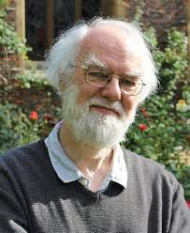
Rowan Williams
Foreword for a Lent book in 2011, wrote
“… we come to understand ourselves more fully as bodily beings, constantly tempted to fantasize ourselves out of the material world and to create boundaries between soul and flesh: humility is, of course, incarnation, recognizing that it is precisely as changing and decaying physical agents that we engage with the real world, not the imagined one that we can manipulate for our satisfaction.’
From: Stephen Cherry. (2011) Barefoot Disciple. Walking the way of Passionate Humility. Continuum, London, p.x

Slide 26
We have recovered a sense of ourselves as bodies, as well as minds and souls, and so we have rediscovered some of the ancient practices of faith, practices that some of our forebears scorned…
Christians from Reformation traditions have sometimes set down their books on spiritual pilgrimage and set out on a literal walk to a physical place and rediscovered the practice of pilgrimage and of faith in a new way. There has been an astonishing and significant rediscovery of the practice of faith, the embodiment of discipleship and the value of ritual, place and physical journey and physical bodies.
‘Pilgrimage’ has re-emerged in the contemporary church in new ways again as a practice, and not simply as a metaphor, as Christians rediscover ancient places of pilgrimage or find new ones.

Slide 27
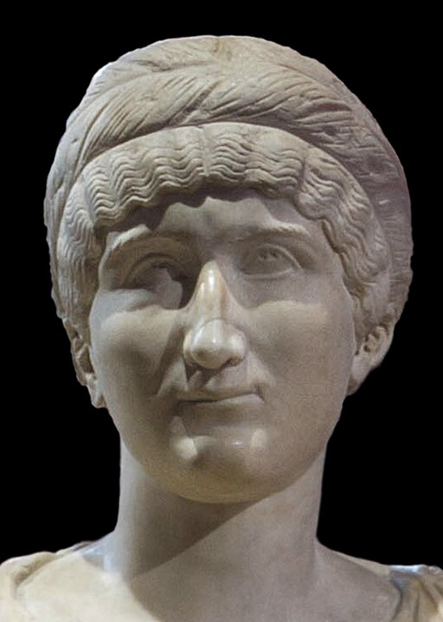
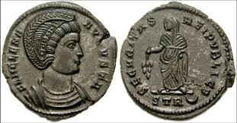
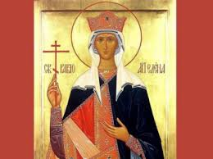
Helena – discovered a faith that has real places…

Slide 28
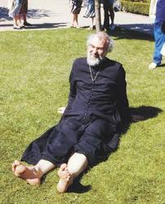
Rowan Williams
‘When I choose to make a pilgrimage it’s not just to make a trip, it’s not just to do some sight-seeing. With a pilgrimage you let things go so that there is enough room for the place and the story to settle in and make an impact. It’s the company, it’s the sharing, and it’s also that sense of stripping down.’
‘The place works on the pilgrim…’

Slide 29
Hymn Tune: Dix
‘Can you help us?’ wise men say,
‘We have come so very far’
looking for a royal child,
guided by his rising star.
Tell us where to find a king
worthy of the gifts we bring.’
  Find him in the innocence
  Of an infant fast asleep;
  Find him in the helplessness
  Of a child, whose parents keep
  Tender vigil, anxious, calm,
  Guarding innocence from harm.

Slide 30
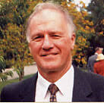
  Then, if you are truly wise,
  you will find his rising star,
  not far off in outer space,
  but within you, where you are.
  By its light, you will be brought
  To the wonder you have sought.
  You will worship and adore;
  You will make your heart his throne.
  Paying homage, you will learn
  What the wise have always known,
  Taught by every infant’s birth;
  Innocence must rule the earth! Alan Gaunt

Slide 31
Helena by Evelyn Waugh
‘Like me’, she said to them, ‘you were late in coming. The shepherds were here long before; even the cattle. They had joined the chorus of angels before you were on your way. For you the primordial discipline of the heavens was relaxed and a new defiant light blazed amid the disconcerted stars.
‘How laboriously you came, taking sights and calculating, where the shepherds had run barefoot! How odd you looked on the road, attended by what outlandish liveries, laden with such preposterous gifts!
You came at length to the final stage of your pilgrimage and the great star stood still above you. What did you do? You stopped to call on Herod. Deadly exchange of compliments in which began that unended war of mobs and magistrates against the innocent!

Slide 32
‘Yet you came, and were not turned away. You too found room before the manger. Your gifts were not needed, but they were accepted and put carefully by, for they were brought with love. In that new order of charity that had just come to life, there was room for you, too. You were not lower in the eyes of the holy family than the ox or the ass.
‘You are my especial patrons,’ said Helena, ‘and patrons of all later-comes, of all who have a tedious journey to make to the truth, of all who are confused with knowledge and speculation, of all who through politeness make themselves partners in guilt, of all who stand in danger by reason of their talents.
‘Dear cousins, pray for me,’ said Helena…

Slide 33
Blessing
May the dark places be blessed with light
and any pain be touched by God’s healing.
May the silences in your days and nights be golden
and the light of each day be soft on your face.
May your pilgrimage be fruitful
and may you be blessed with good companions on God’s way.
The blessing of God…

