Slide 1
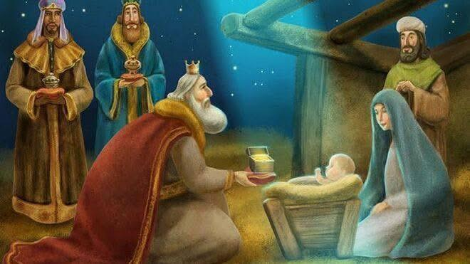

Slide 2
Come to the cradle of creation,
to the child in the manger.
We come here today, drawn by that one light.
Lift up your eyes,
look around you at the work of God.
We have seen God’s glory,
and our hearts thrill!

Slide 3
Come with those who brought gold and incense and myrrh.
We bring ourselves
and we proclaim the praise of God …
(Susan Durber. Reprinted from Immersive Joy
(2025 United Reformed Church Prayer Handbook)
© The United Reformed Church 2024)

Slide 4
Matthew 2: 1-12

Slide 5
Now when Jesus was born in Bethlehem of Judaea in the days of Herod the king, behold, there came wise men from the east to Jerusalem, asking, ‘Where is the child who has been born King of the Jews? For we observed his star at its rising, and have come to pay him homage. When King Herod heard this, he was frightened, and all Jerusalem with him; and calling together all the chief priests and scribes of the people, he inquired of them where the Messiah was to be born.

Slide 6
They told him, ‘In Bethlehem of Judea; for so it has been written by the prophet:
“And you, Bethlehem, in the land of Judah,
Are by no means least among the rulers of Judah; for from you shall come a ruler who is to shepherd my people Israel.”’
Then Herod secretly called for the wise men and learned from them the exact time the star had appeared. Then he sent them to Bethlehem, saying, ‘Go and search diligently for the child; and

Slide 7
when you have found him, bring me word so that I may also go and pay him homage.’
When they had heard the king, they set out; and there, ahead of them, went the star, that they had seen at its rising, until it stopped over the place where the child was.
When they saw that the star had stopped, they overwhelmed with joy.

Slide 8
On entering the house, they saw the child with Mary his mother, and they knelt down, and paid him homage. Then, opening their treasure-chests, they offered him gifts of gold, frankincense and myrrh.
And having been warned in a dream not to return to Herod, they left for their own country by another way.

Slide 9
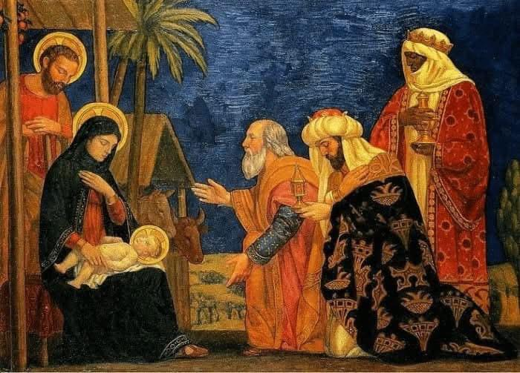

Slide 10
Eternal God, by a star
you led wise men to the worship of your Son.
Guide by your light the nations of the earth,
that the whole world may know your glory: through Jesus Christ our Lord,
who lives and reigns
with you and the Holy Spirit,
one God, now and for ever.
Amen.
(Collect for Epiphany - Book of Common Order
of the Church of Scotland.)

Slide 11
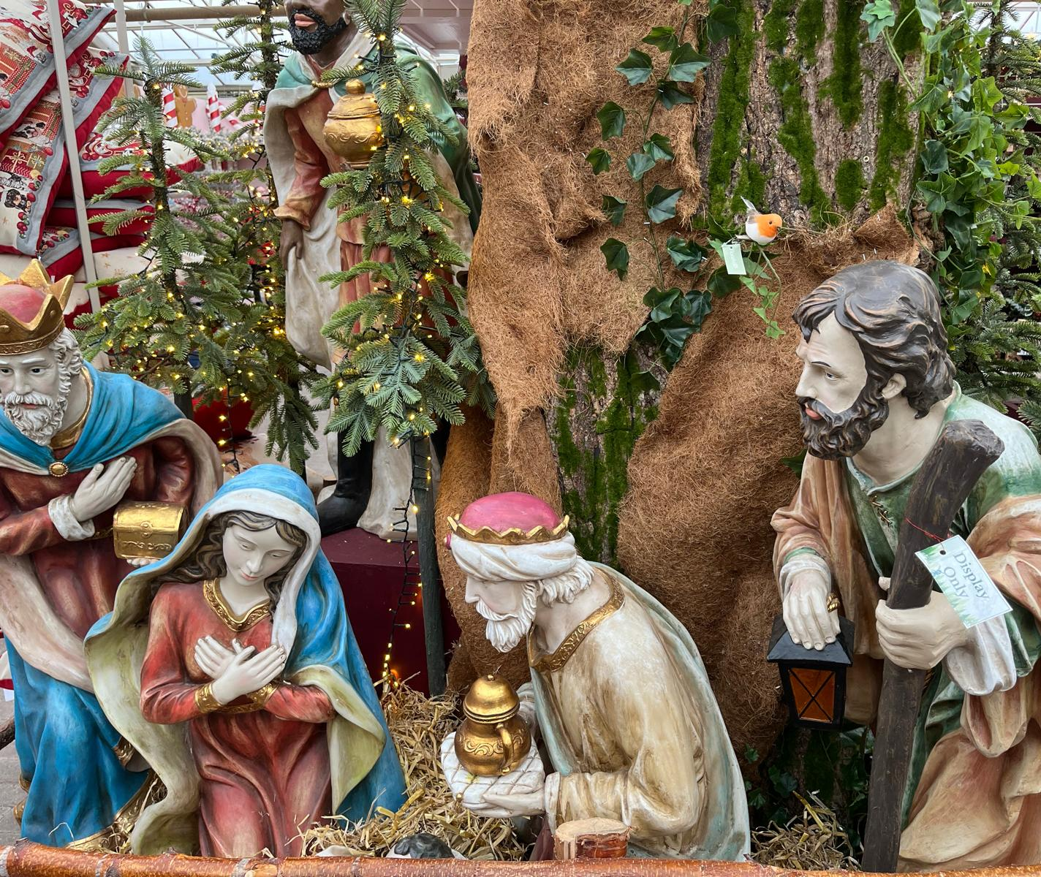
Epiphany?
Done and dusted …
(subsumed into Christmas)

Slide 12
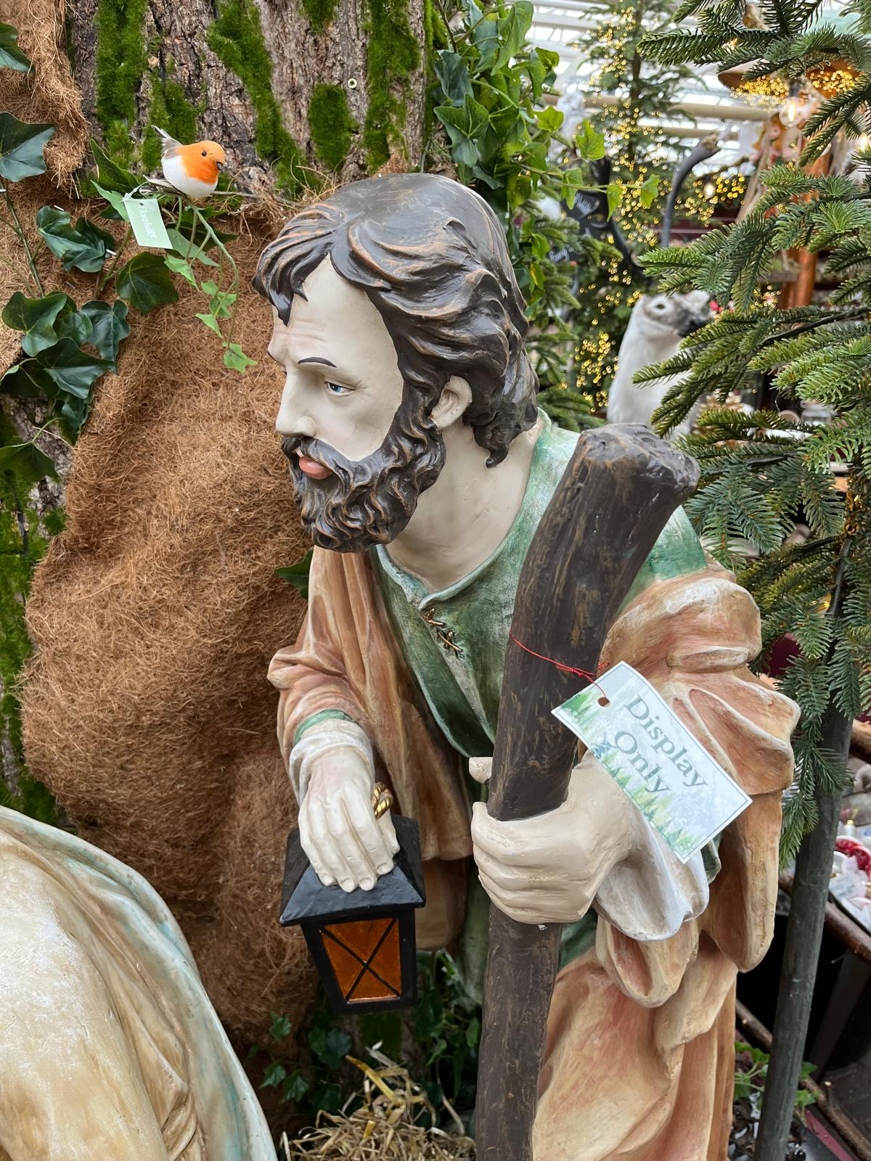

Slide 13
For Reflection:
To what extent has ‘my Christmas’ prevented me glimpsing something fresh beyond ‘display’?

Slide 14
Hymn: Songs of thankfulness and praise
https://youtu.be/j3ROyZGTHIg

Slide 15
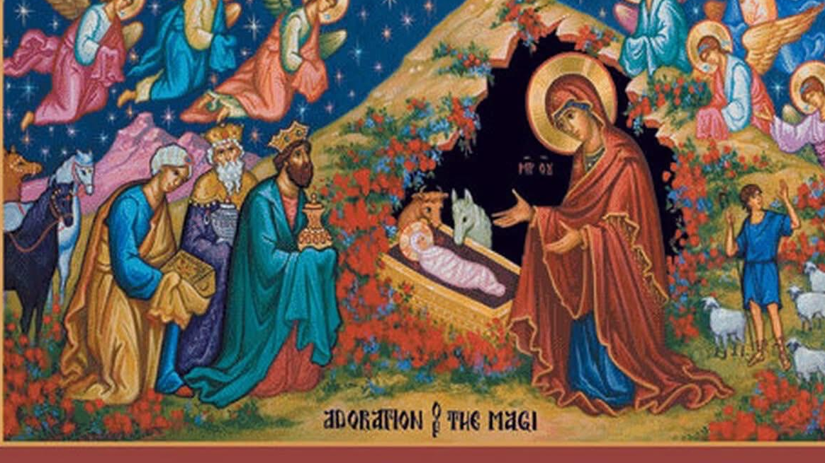
And more …

Slide 16
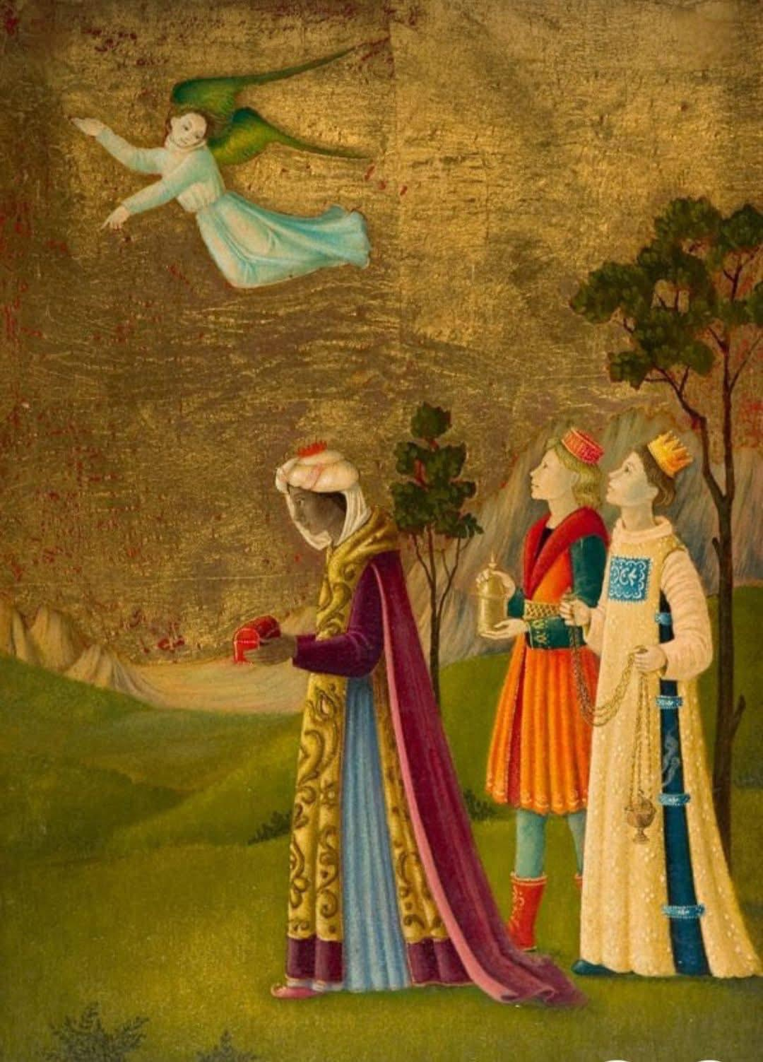
AND MORE …
Asking …
Overwhelmed by joy …
Kneeling …
Paying homage …
Opening treasure-chests …
Offering gifts …

Slide 17
Epiphany: God made manifest …
Readiness to take a different route …

Slide 18
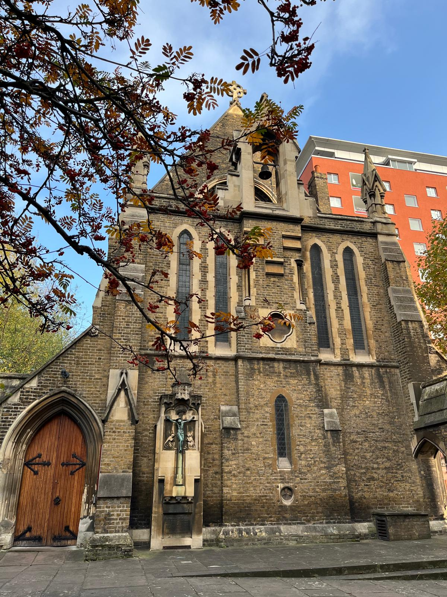

Slide 20
And more …

Slide 22
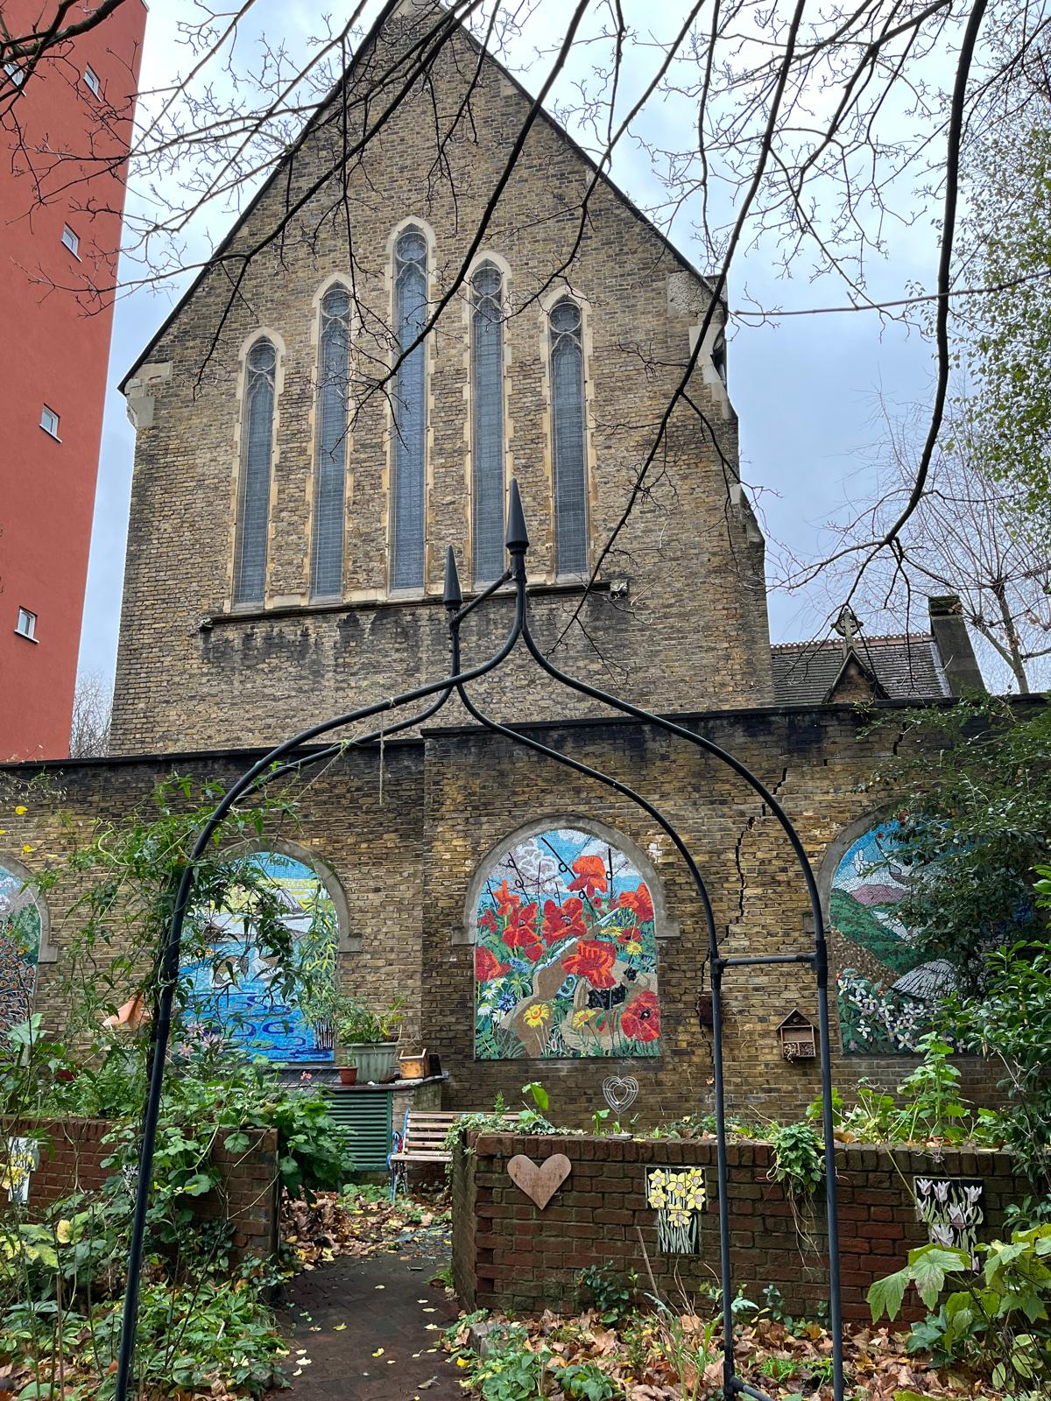
Christ has many services to be done:
some are easy, others are difficult;
some bring honour, others bring reproach;
some are suitable
to our natural inclinations
and material interests,
others are contrary to both;
in some we may please Christ
and please ourselves;
in others we cannot please Christ
except by denying ourselves …

Slide 23
How willing am I to stray from the path of familiarity …
Paths contrary to my natural inclinations and material interests?

Slide 24
And more …

Slide 25
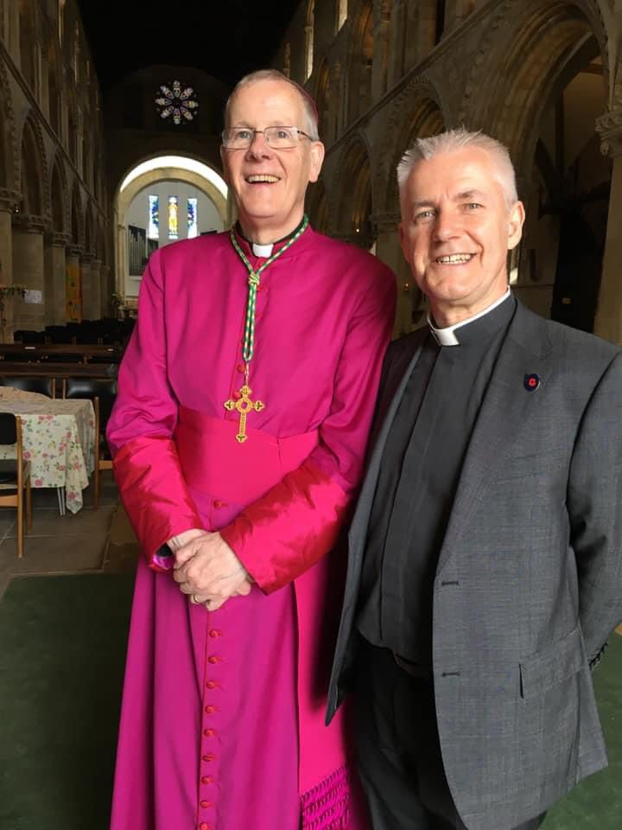
Epiphany: God made manifest …
Willingness to engage with those different to us …
God made manifest through those different to us …

Slide 26
How willing am I to be open to those with whom I differ …
those whose ways are different to mine?

Slide 27
Hymn: Carol of the Epiphany
https://youtu.be/mZsrQzYCXqg

Slide 28
The Magi – by Malcolm Guite

Slide 29
It might have been just someone else’s story;
Some chosen people get a special king,
We leave them to their own peculiar glory,
We don’t belong, it doesn’t mean a thing.

Slide 30
But when these three arrive
they bring us with them,
Gentiles like us, their wisdom might be ours;
A steady step that finds an inner rhythm,
A pilgrim’s eye that sees beyond the stars.

Slide 31
They did not know his name
but still they sought him,
They came from otherwhere but still they found;

Slide 32
In palaces, found those who sold and bought him,
But in the filthy stable, hallowed ground.
Their courage gives our questing hearts a voice
To seek, to find, to worship, to rejoice.
Malcolm Guite: Sounding the Seasons.
© Malcolm Guite 2012

Slide 33
And more …

Slide 34
Epiphany: God made manifest …
Through generosity: gold …
frankincense …
myrrh …
… our own ...
… that of others …

Slide 35
How willing am I
to bend the knee …
How open are my treasure-chests …

Slide 36
Hymn: Brightest and best of the sons …
https://www.youtube.com/watch?v=YloQJT5lNvc

Slide 37
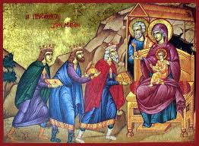
Star child,
wanted and welcomed by the humble,
hated and hounded by power-seekers:
refuge and refugee,
we love you!

Slide 38
Apple of God’s eye,
cherished and chosen by Kingdom-travellers,
rejected and ridiculed by the earth-bound:
sacred and scarred,
we honour you!

Slide 39
Light of the world,
tended and treasured by the pure in heart,
shadowed and shunned by the deceitful:
peerless and pierced,
we exalt you!
Kate Compston
(from Seasons and Celebrations,
compiled by Donald Hilton.)

Slide 40
And more …

Slide 41
Epiphany: God made manifest …
Always more …
beyond “our poor reach of mind” …

Slide 42
We limit not the truth of God
To our poor reach of mind,
By notions of our day and sect,
Crude, partial, and confined:
No, let a new and better hope
Within our hearts be stirred:
The Lord hath yet
more light and truth
to break forth from his word.

Slide 43
O Father, Son, and Spirit, send
Us increase from above:
Enlarge, expand
all Christian souls
To comprehend thy love:
And make us all go on to know,
With nobler powers conferred,
The Lord hath yet
more light and truth
to break forth from his word.

Slide 46
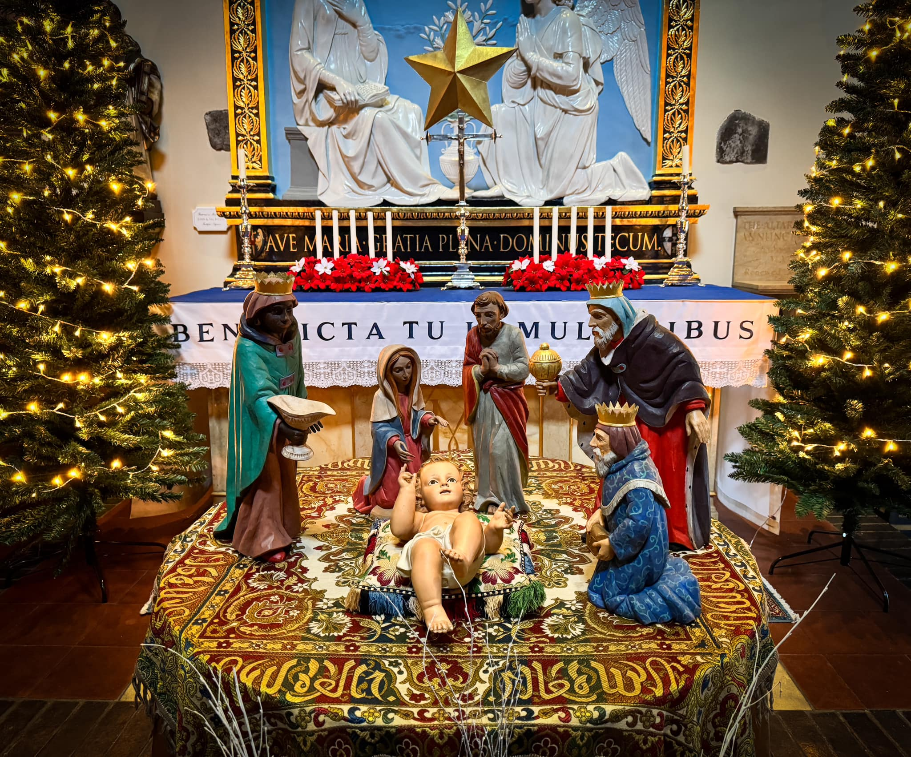
Our singing heart,
our day’s doxology, our gold,
we bring for celebration.
Our stillness, our glimpses of serenity, our frankincense,
we bring for meditation.
Our brokenness, our tears of rage and sorrow, our myrrh,
we bring for sacrifice.
Kay Compston, op cit.

